Slide 1

ROCKBUSTER STEALTH
Data Analysis for Film Rental Market
Michael Higgins
July 2019

Slide 2

MOTIVATION
OBJECTIVE
Rockbuster Stealth is a movie rental company facing increasing competition from online streaming services.
The management team is planning to use its existing movie licences to launch an online video rental service in 2020.
The focus of these analyses are to determine the marketplaces that will generate most revenue based on Rockbuster Stealth’s existing client base and their spending habits. This is to include the location of customers, and on which kinds of films they spend their money.

Slide 3

ABOUT ROCKBUSTER
Data summary
16,044
1,000
584
108
$4.20
Rentals made
Active customers
Average rental cost
Total films
Countries worldwide

Slide 4
MARKET TRENDS
VIDEO STORES
ONLINE FILMS
ONLINE REVENUE
From 2007 to 2017 86% of video stores in the USA have closed
Film streaming increased by 24.3% from 2017 to 2018
PHSYCIAL RENTALS
Video rentals across the USA fell to $390 million in 2017.
Global video streaming generated over £70 billion in 2018

Slide 5
ANALYSIS FOCI
01
02
03
04
LOCATIONS
Where are our customers and where generates the most revenue?
CUSTOMERS
How much extra are top customers spending?
GENRES
Which types of film are most popular?
RATINGS
How does age rating affect most rental income?

Slide 6

01
LOCATIONS
Where are our customers, and where generates the most revenue?

Slide 7
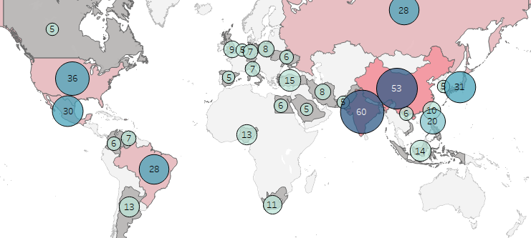
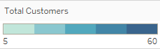
WHERE ARE CUSTOMERS BASED?
The map shows the countries with at least 5 registered customers, and the total income generated from these locations.
Rockbuster’s top 5 customer bases are:
India…………………… 60
China…………………… 53
USA………………………… 36
Japan…………………… 31
Mexico………………… 30
Total Customers
Gross Income (Q2)
5
60
$450
$8,500

Slide 8
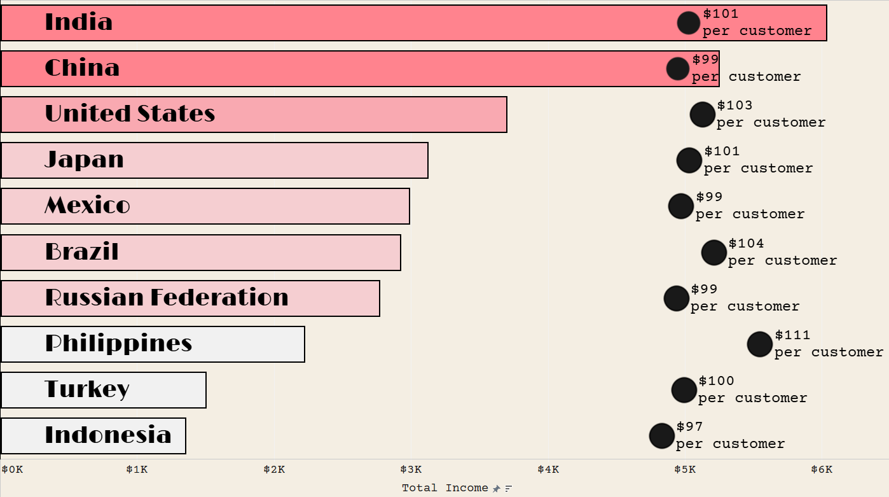
TOP 10 COUNTRIES
GROSS INCOME
The most profitable countries are mainly in Asia (6 of the top 10), with earnings ranging from $1,350 (Indonesia) to $6,000 (India).
3 of the remaining 4 are in the Americas.
INCOME PER CUSTOMER
Earnings per customer for these regions are consistent, averaging $101. The Phillippines is the only outlier at $111 per customer.
$0K
$1K
$2K
$3K
$4K
$5K
$6K
Total Revenue

Slide 9

02
CUSTOMERS
How much extra are top customers spending?

Slide 10
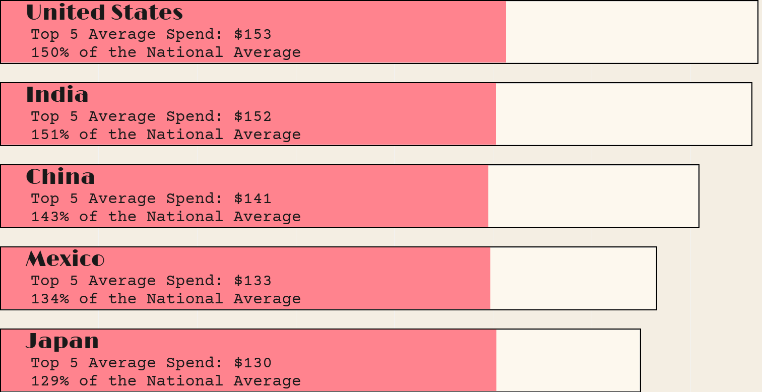
LOYALTY BONUS
+$51
+$51
Loyal customers are worth from $29 to $52 additional revenue across these countries.
They average $41 extra spent compared to their compatriots.
The top 3 individual spends in these countries were:
Karl S. (USA)…………$209
Ana B. (USA)…………$168
Mike W. (India)……$163
+$52
+$52
+$42
+$42
+$33
+$33
+$29
+$29
$0
$20
$40
$60
$80
$100
$120
$140
Average national spend per customer
Average additional spending by National Top 5 customers
Income per Customer

Slide 11

03
GENRES
Which types of film are most popular?

Slide 12
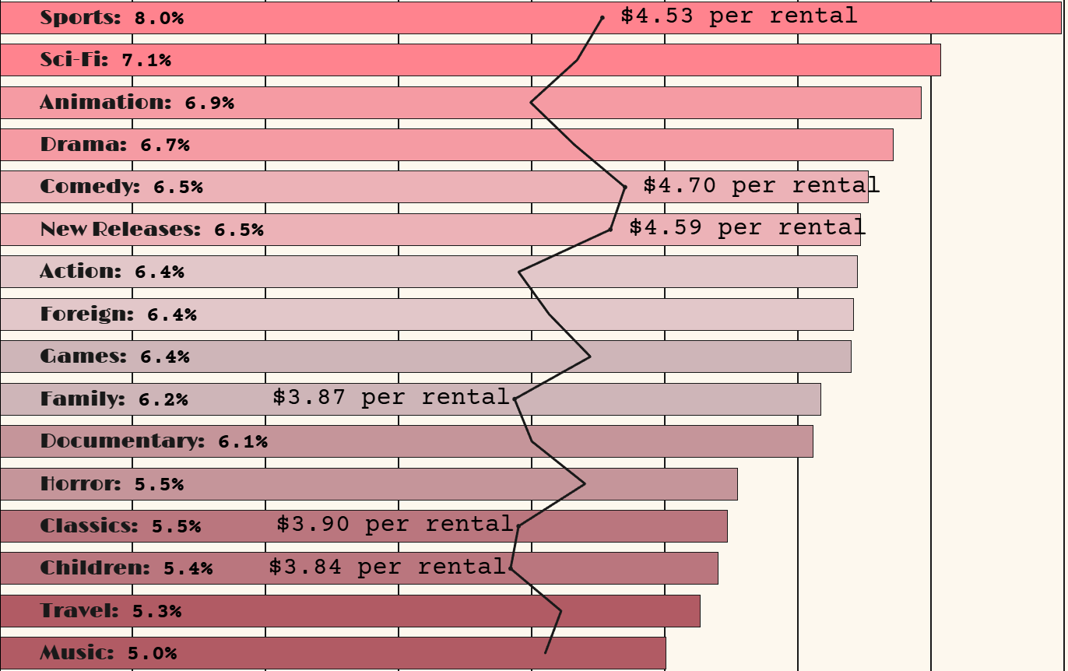
INCOME BY GENRE
Percent of Revenue
Highest proportion of revenues were:
Sports…………………… 8.0%
Sci-Fi…………………… 7.1%
Animation…………… 6.9%
0%
1%
2%
3%
4%
5%
6%
7%
8%
Highest earnings per rental were:
Comedy………………… $4.70
New Releases… $4.59
Sports………………… $4.53
(Average = $4.20)
$0
$1
$2
$3
$4
$5
$6
$7
$8
Average Income per Rental
(Top and Bottom 3 Labelled)

Slide 13

04
RATINGS
How does age rating affect rental income?

Slide 14
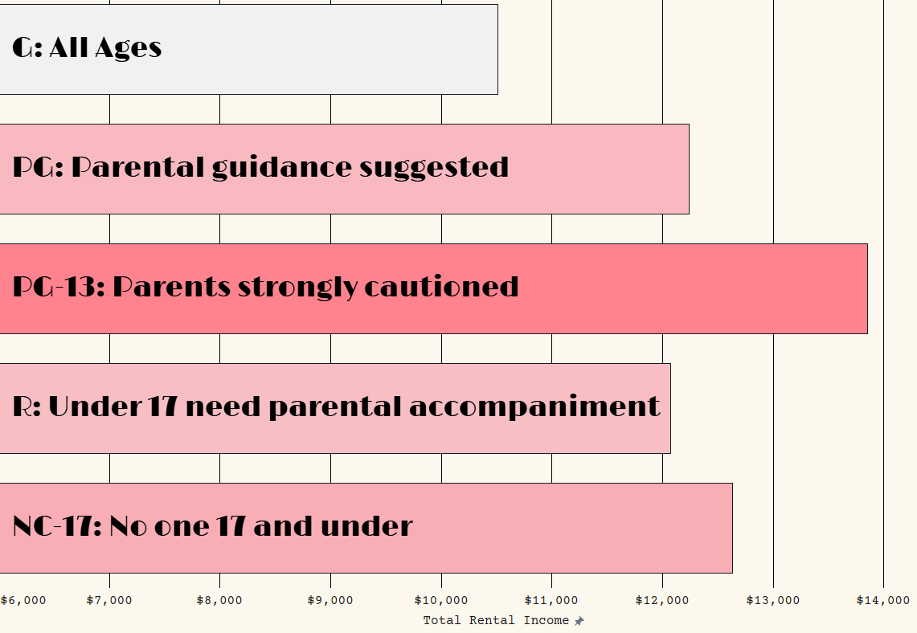
REVENUE AND RATINGS
PG-13 films generate the highest revenue, at $13,856
The lowest earning category was G, at $10,512
The other categories produced between $12,000 and $12,700

Slide 15

SUMMARY AND RECOMMENDATIONS
Key points for future decisions

Slide 16




SUMMARY DATA
LOCATION: INCOME
RATINGS: POPULARITY
The majority of big rental revenue countries are in Asia.
PG-13 films outperform others by over $1,000.
CUSTOMERS: SPENDING
CUSTOMERS: LOYALTY
In the largest markets the average customer spent $101 on rentals.
Loyal customers were worth on average $41 extra.
GENRE: REVENUE
GENRE: PROFITABILITY
8% of all revenue is sports films.
Comedies make the most per rental, at $4.70.

Slide 17




RECOMMENDATIONS
LOCATION
When launching the online streaming site prioritise marketing to countries in Asia. These markets are large and generate the most customers and income.
CUSTOMERS
A top customer is worth an average 40% extra income, incentivise spending with loyalty rewards schemes to encourage more people to spend big.
GENRES
People will pay more for comedies and new releases, make deals with movie distribution studios to increase the number of these films in the online catalogue.
To view visualisations used in this presentation please visit:
Michael Higgins Tableau Public
CREDITS: Template by Slidesgo,and includes icons by Flaticon, and infographics & images by Freepik

